Slide 1



Loan Analysis
View in Power BI
Last data refresh:
16/07/2023 15:53:05 UTC
Downloaded at:
09/11/2023 15:43:15 UTC

Slide 2
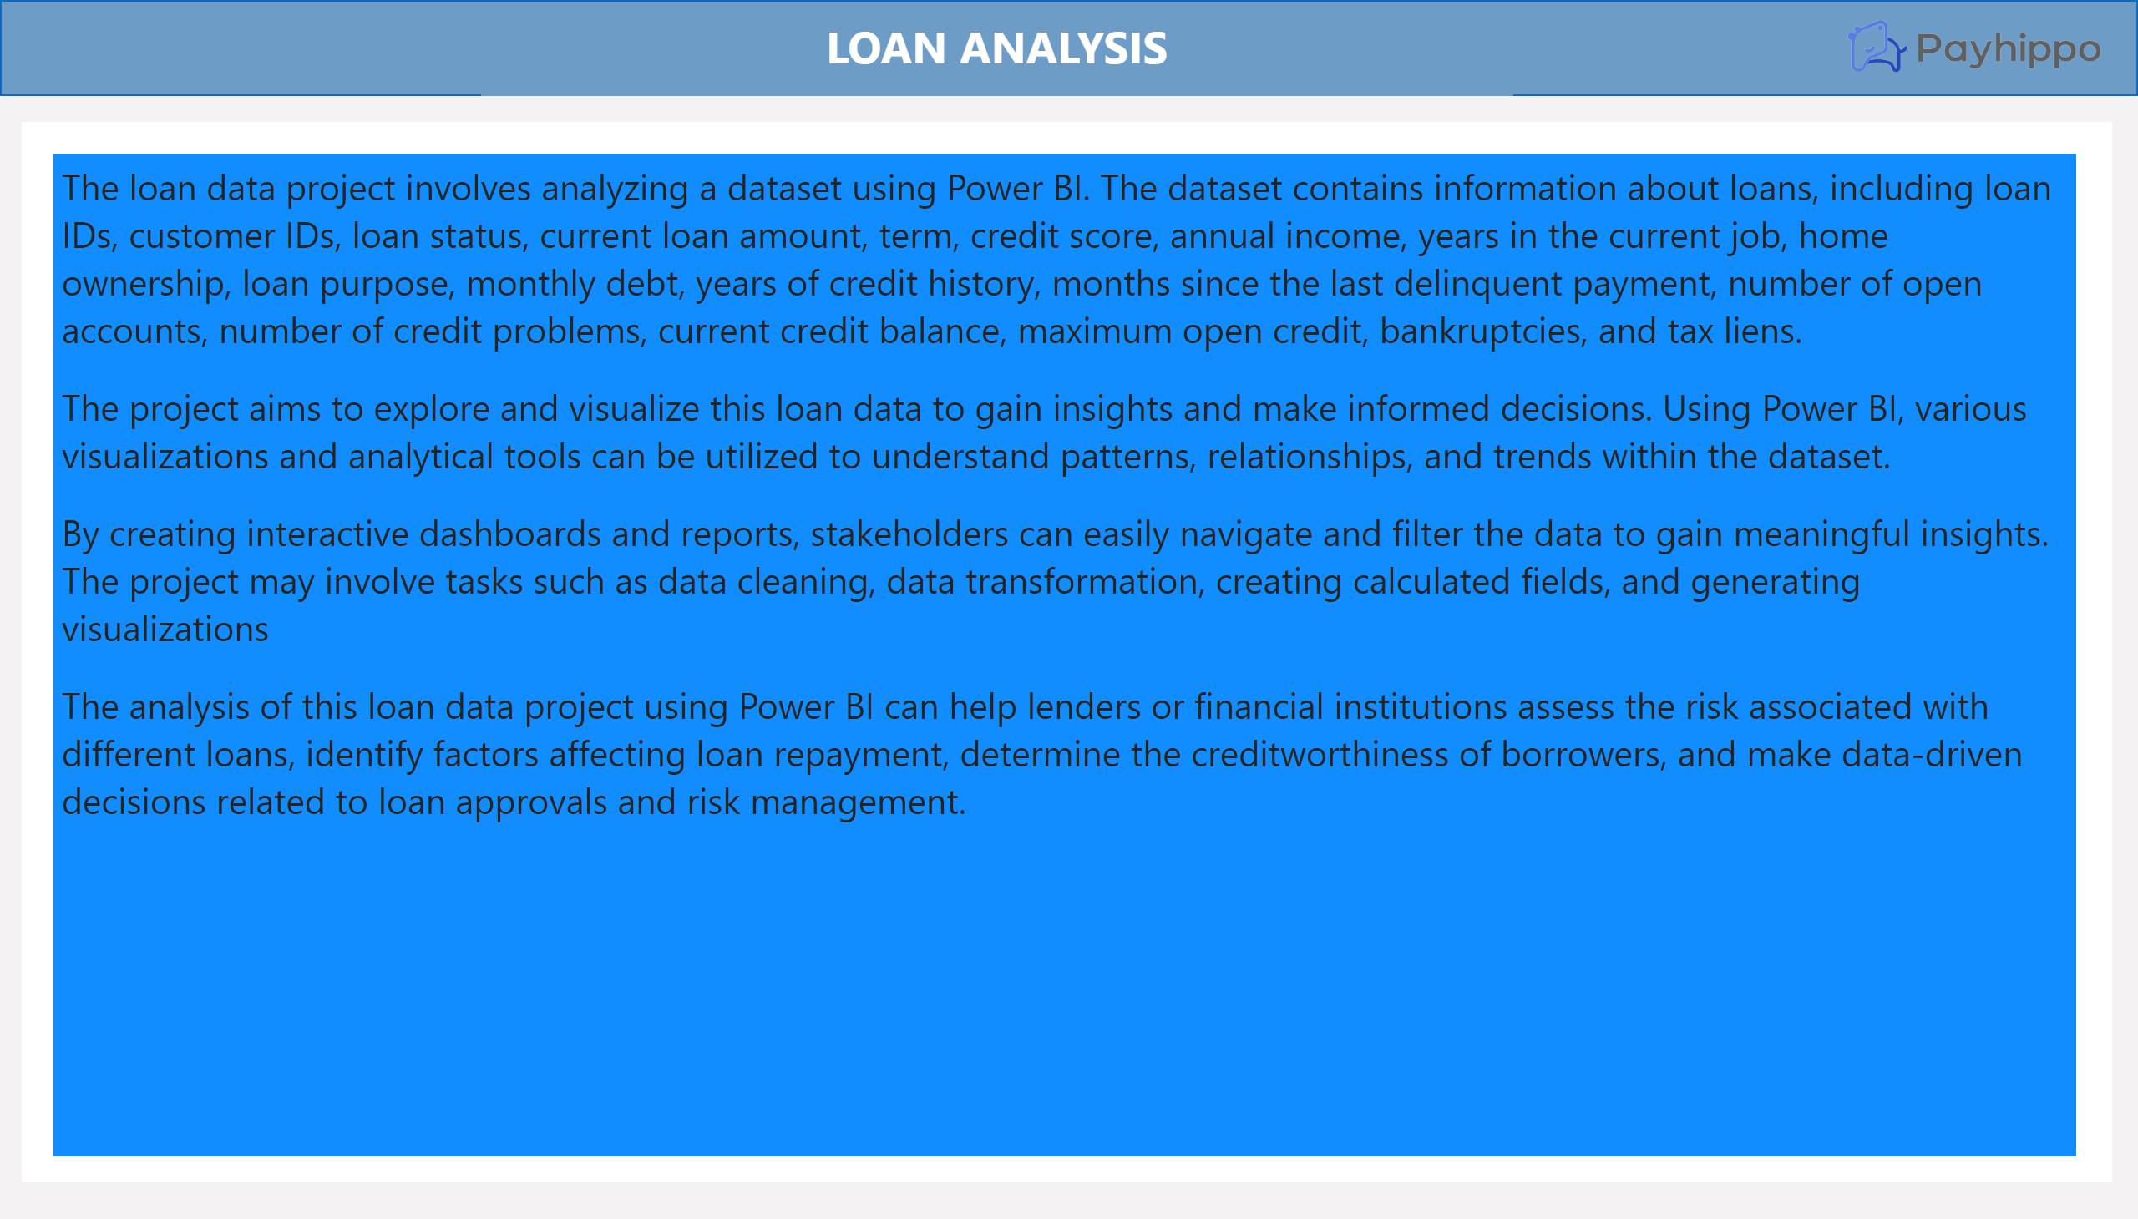
Summary
Notes:
shape
No alt text provided
textbox
No alt text provided
image
No alt text provided
shape
No alt text provided
textbox
No alt text provided

Slide 3
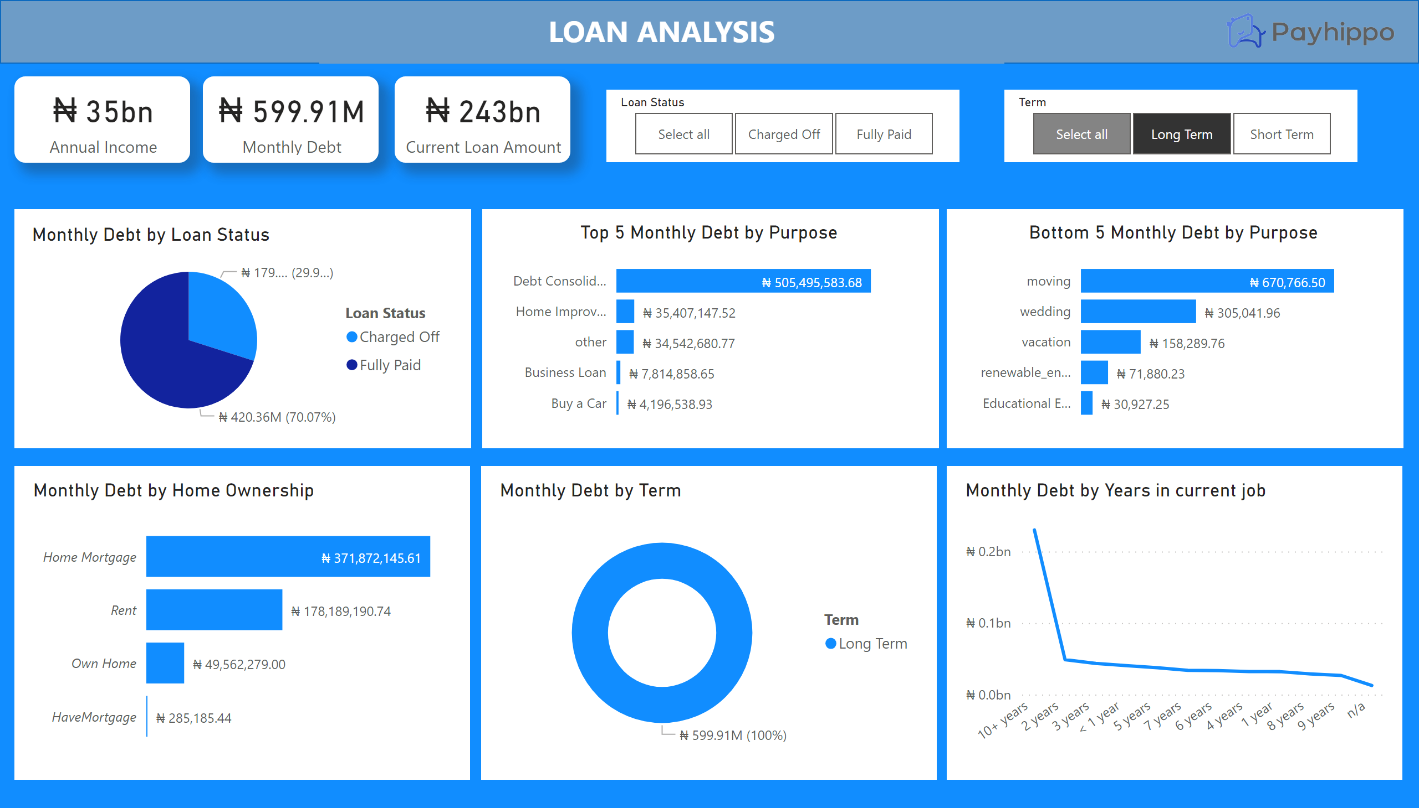
Page 1
Notes:
shape
No alt text provided
textbox
No alt text provided
image
No alt text provided
card
No alt text provided
card
No alt text provided
card
No alt text provided
shape
No alt text provided
shape
No alt text provided
shape
No alt text provided
Monthly Debt by Loan Status
No alt text provided
Top 5 Monthly Debt by Purpose
No alt text provided
Bottom 5 Monthly Debt by Purpose
No alt text provided
shape
No alt text provided
shape
No alt text provided
shape
No alt text provided
Monthly Debt by Home Ownership
No alt text provided
Monthly Debt by Term
No alt text provided
Monthly Debt by Years in current job
No alt text provided
slicer
No alt text provided
slicer
No alt text provided

Slide 4
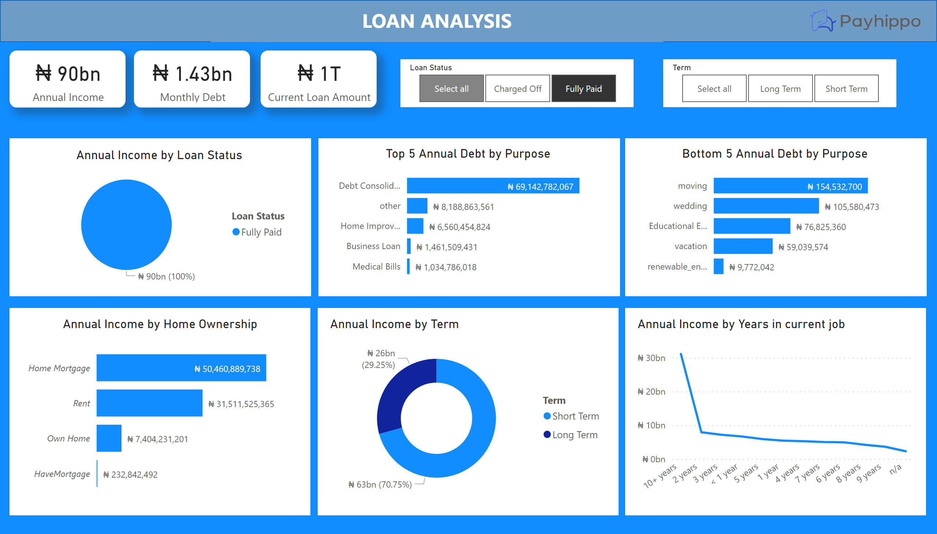
Page 2
Notes:
shape
No alt text provided
textbox
No alt text provided
image
No alt text provided
card
No alt text provided
card
No alt text provided
card
No alt text provided
shape
No alt text provided
shape
No alt text provided
shape
No alt text provided
Annual Income by Loan Status
No alt text provided
Top 5 Annual Debt by Purpose
No alt text provided
Bottom 5 Annual Debt by Purpose
No alt text provided
shape
No alt text provided
shape
No alt text provided
shape
No alt text provided
Annual Income by Home Ownership
No alt text provided
Annual Income by Term
No alt text provided
Annual Income by Years in current job
No alt text provided
slicer
No alt text provided
slicer
No alt text provided

